Slide 1
Chasing the Sale

Slide 2
Word has spread throughout the walls of Ascensus and across the nation. There have been rumors of increased activity, heightened focus, and intense determination in our Sales leadership.
It all started several weeks ago.
First it was a just a murmur with whispers in the hall: “Have you seen that look in Anthony’s eyes? He always is on the go…even more than usual.”
Then it became a buzz. “Mike has plans. Something big is happening .”
Finally, we decided it was time to investigate when word got out that “Mike & Anthony have found the secret to all things AWESOME.”
So, we tracked them for several days to find out…

Slide 3
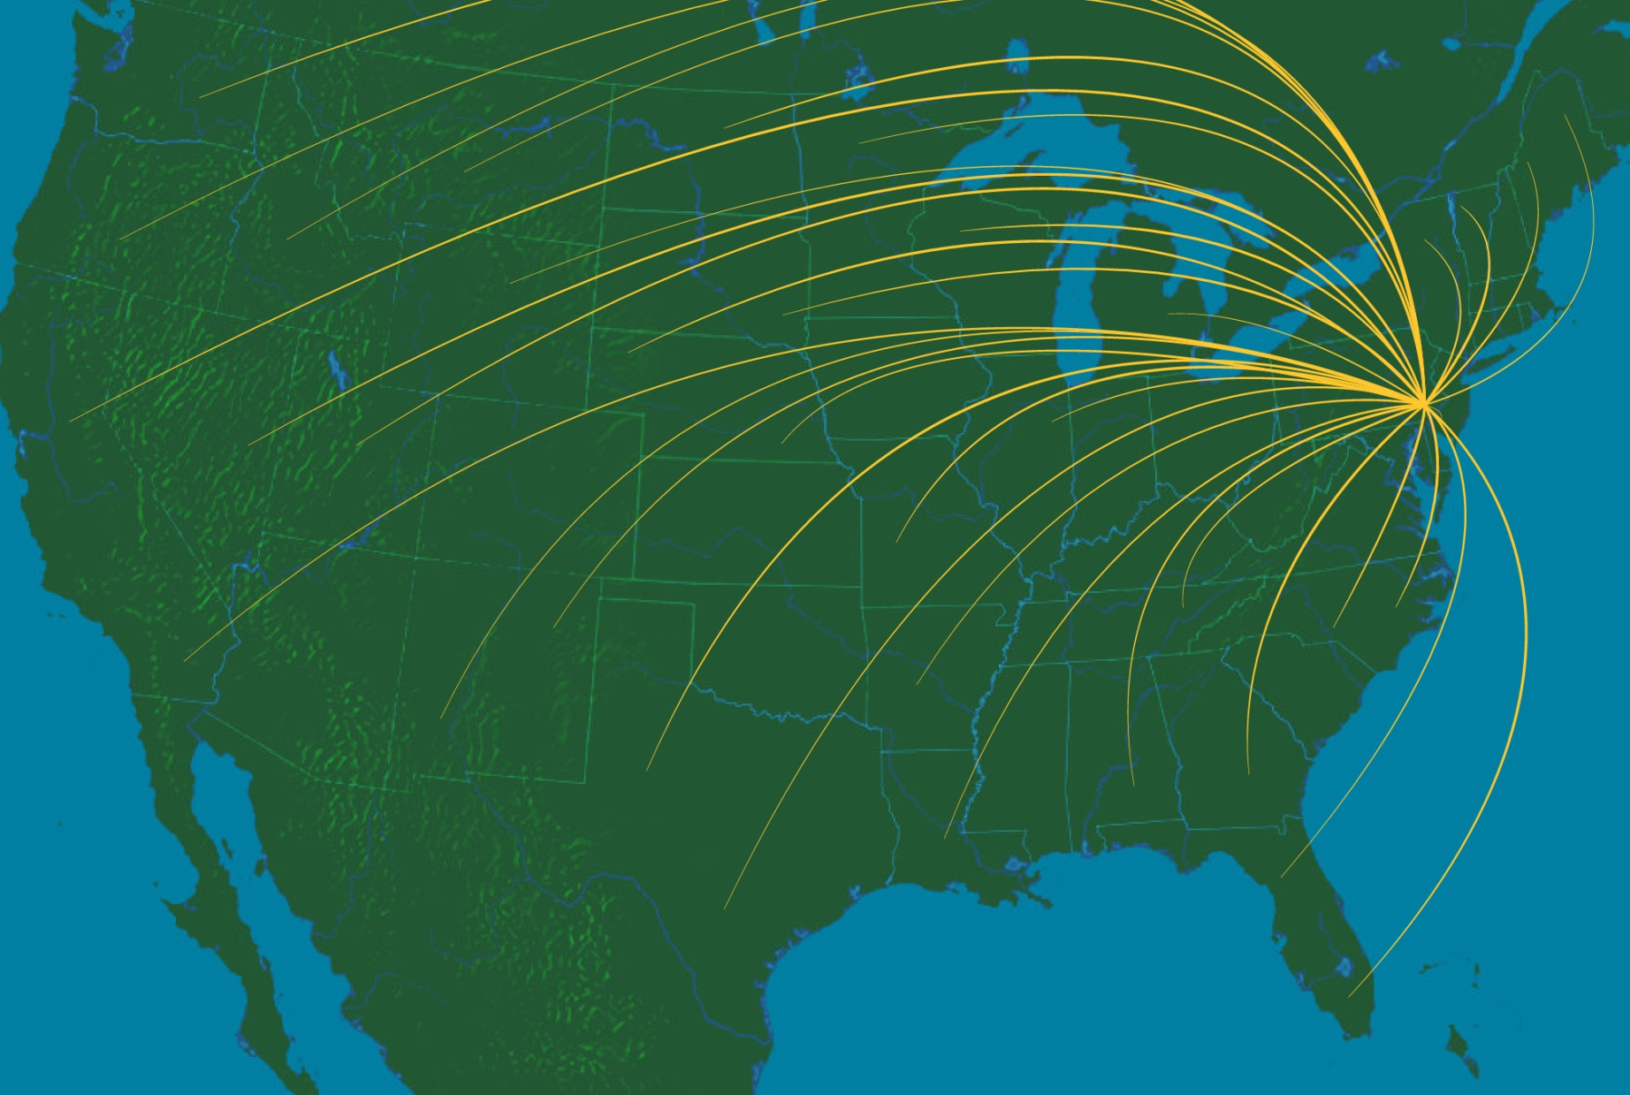
There was truth to the what was being said.
Their travels took them all over the U.S

Slide 4
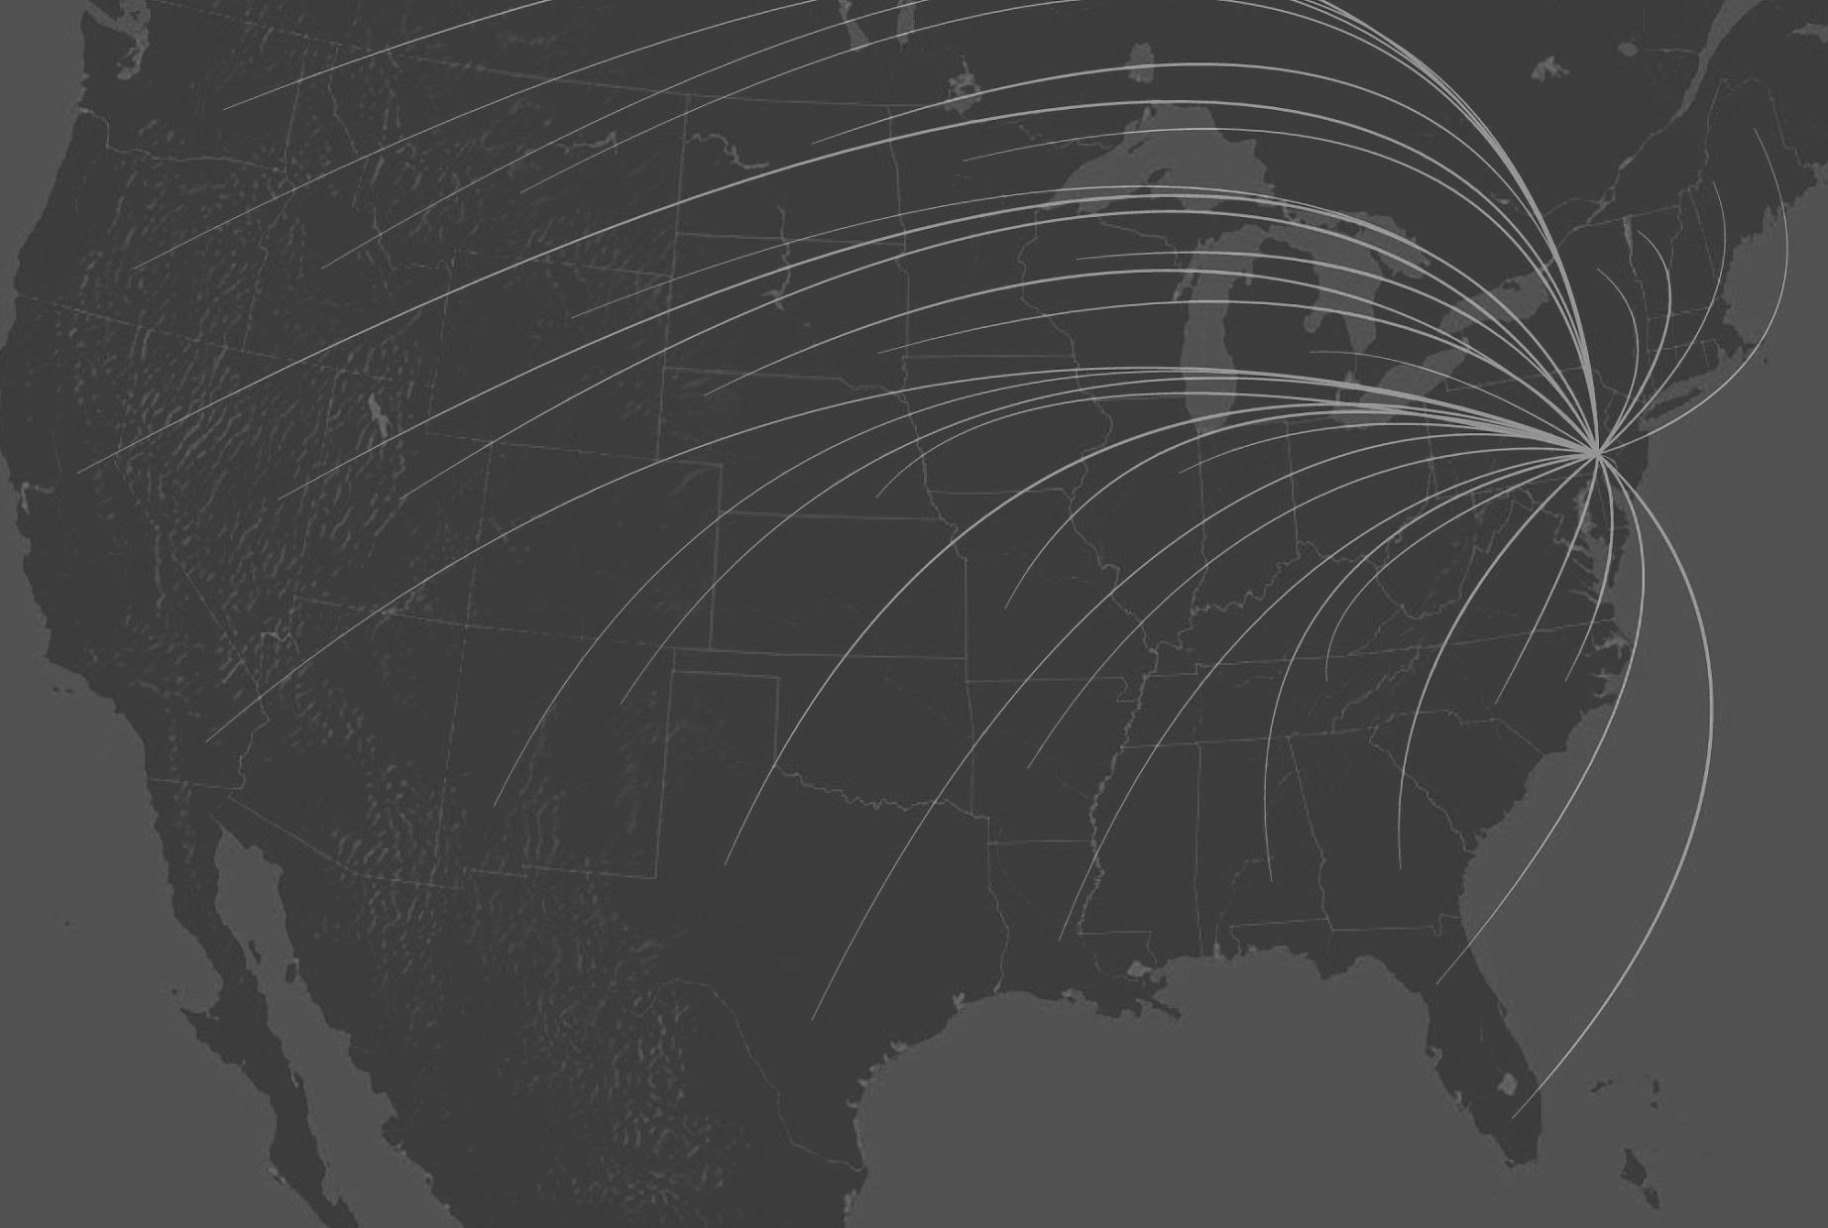
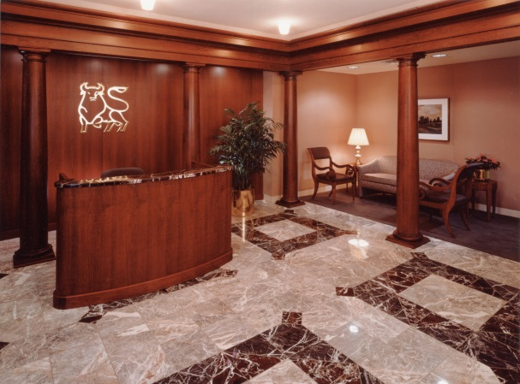
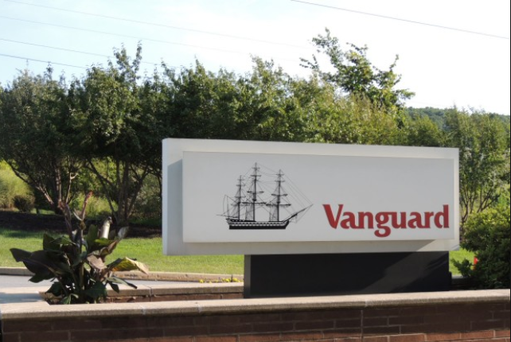
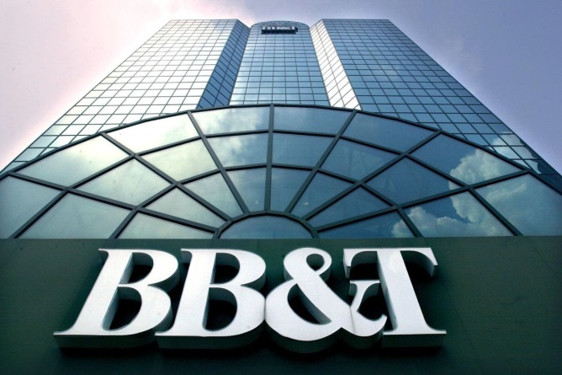
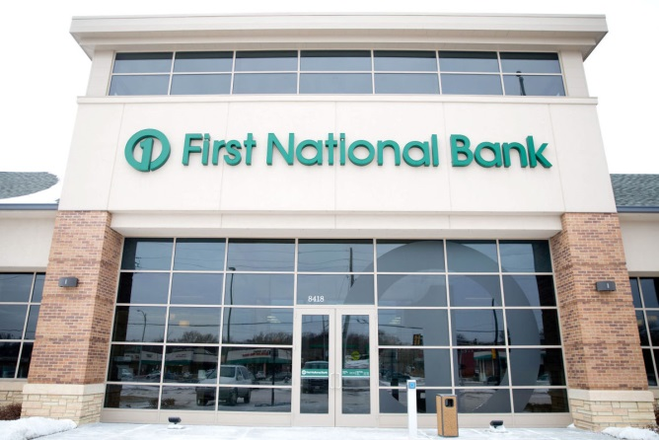
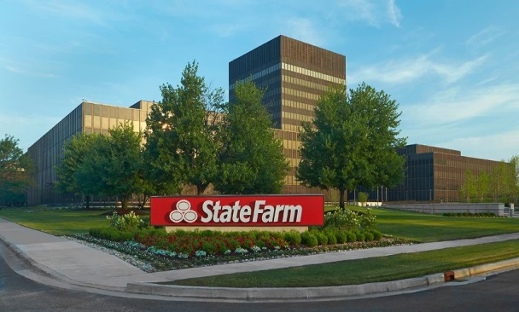
With many notable stops along the way…
LPL, San Diego
Merrill Lynch, NYC
Vanguard, Malvern
BB&T, Winston-Salem
State Farm, Bloomington
FNBO, Omaha

Slide 5
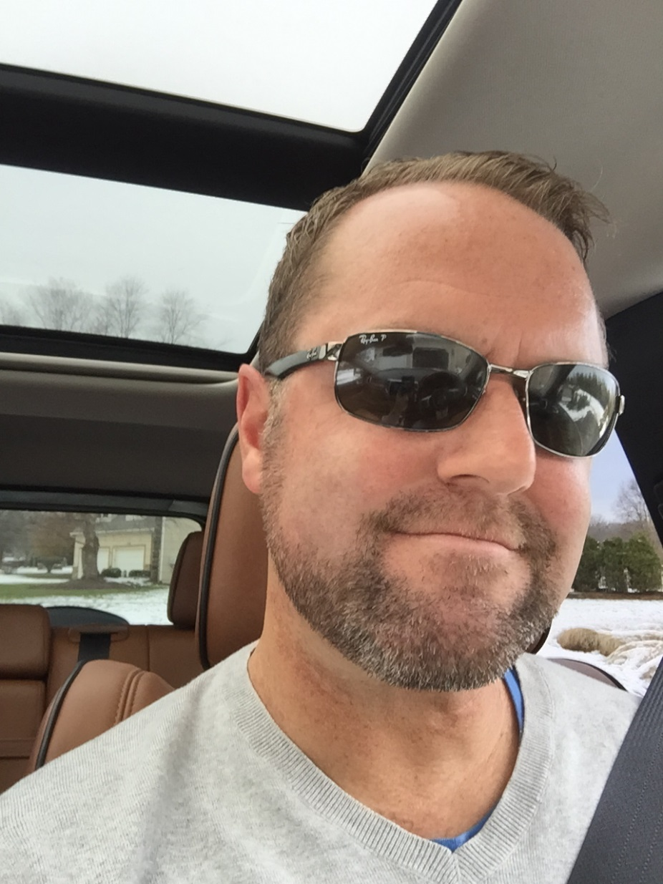

Slide 6
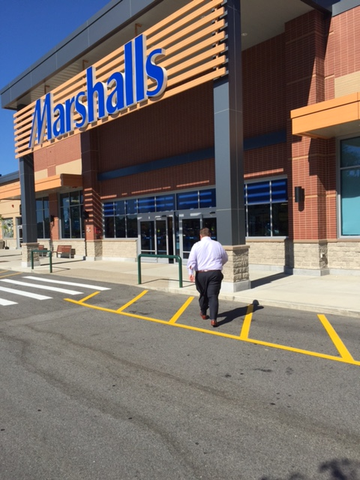
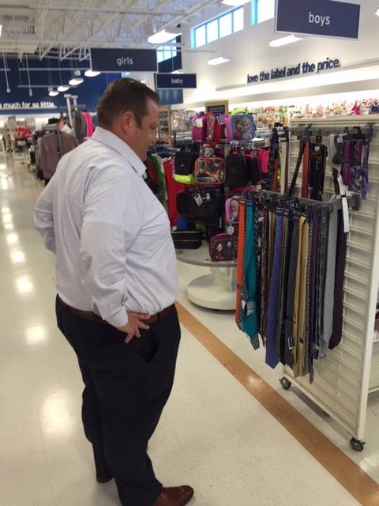
Some unexpected…
Perhaps a clue to AWESOME?
Ninety percent rayon!

Slide 7
Whatever they were doing had to be important, big, game-changing. A fresh opportunity? A hot prospect? A new sales strategy?
We decided it was time to speak with those who know them best.
Managed Accounts Concepting
Notes:
Open Item: Email Standards???

Slide 8
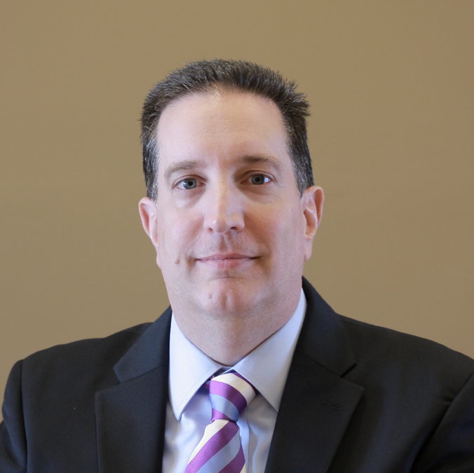
There has been a notable increase in travel expenses. What’s odd, many of the places aren’t anywhere near client offices.
I’d agree something is up.
Confidential. For Ascensus Internal purposes only. Not intended for use with or distribution to clients or the public.

Slide 9
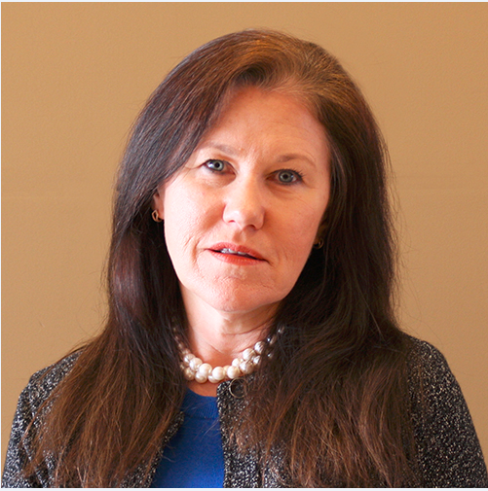
Mike and Anthony mentioned something about looking into opportunities that no one else has tapped into yet.
That’s all I know at this point.
Confidential. For Ascensus Internal purposes only. Not intended for use with or distribution to clients or the public.

Slide 10
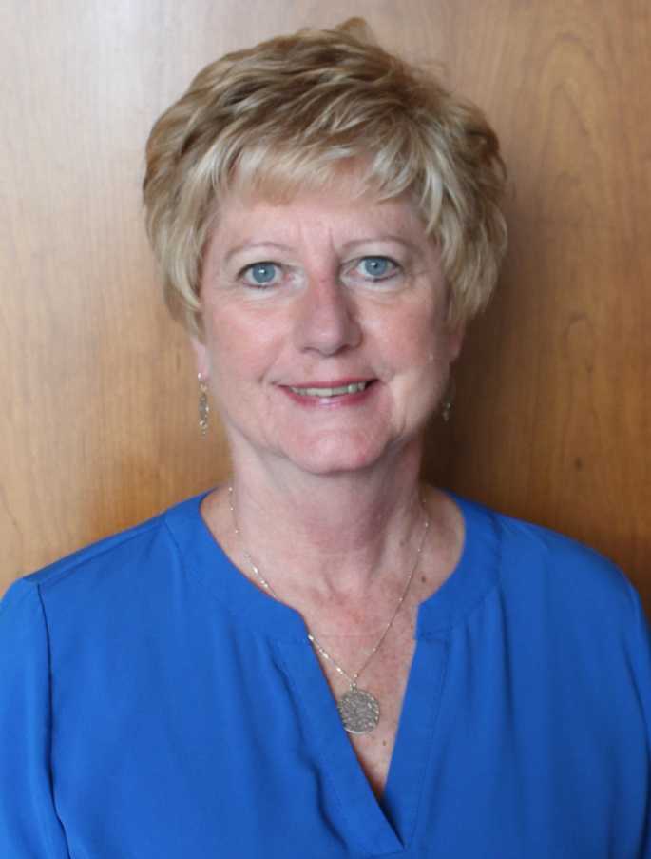
I’d love to know what Anthony and Mike are up to. I just keep getting these random requests without much detail.
That and they set up their own special score board just for the two of them, and they periodically will go over and ring the bell with no explanation.
Confidential. For Ascensus Internal purposes only. Not intended for use with or distribution to clients or the public.

Slide 11
Confidential. For Ascensus Internal purposes only. Not intended for use with or distribution to clients or the public.

Slide 12
Clearly something was UP!
And then we discovered the truth.
We found the secret to AWESOME.
Managed Accounts Concepting
Notes:
Open Item: Email Standards???

Slide 13
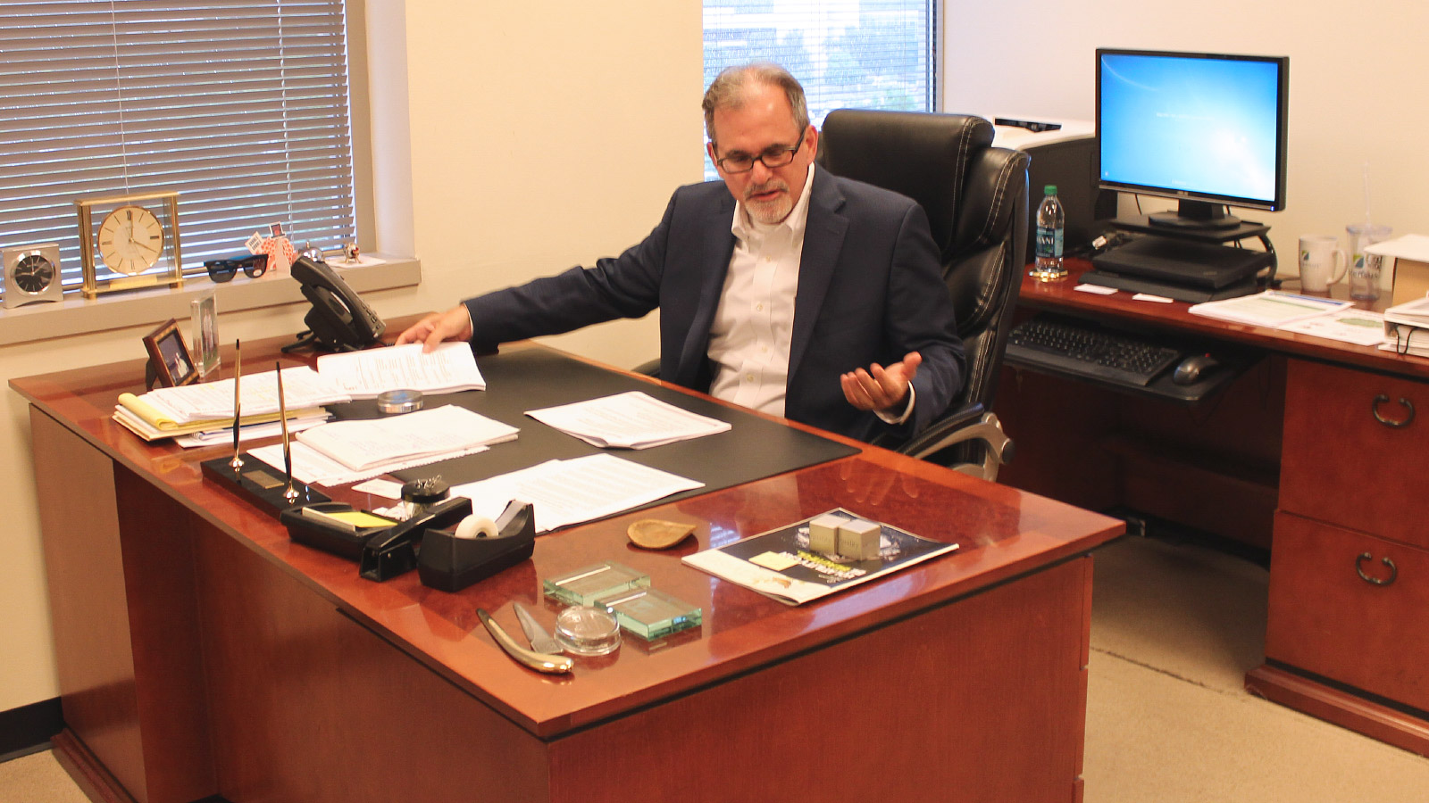
We followed them into Neil’s office. We overheard them explain that they wanted to update him on the latest sales stats… but there was more to it.

Slide 14
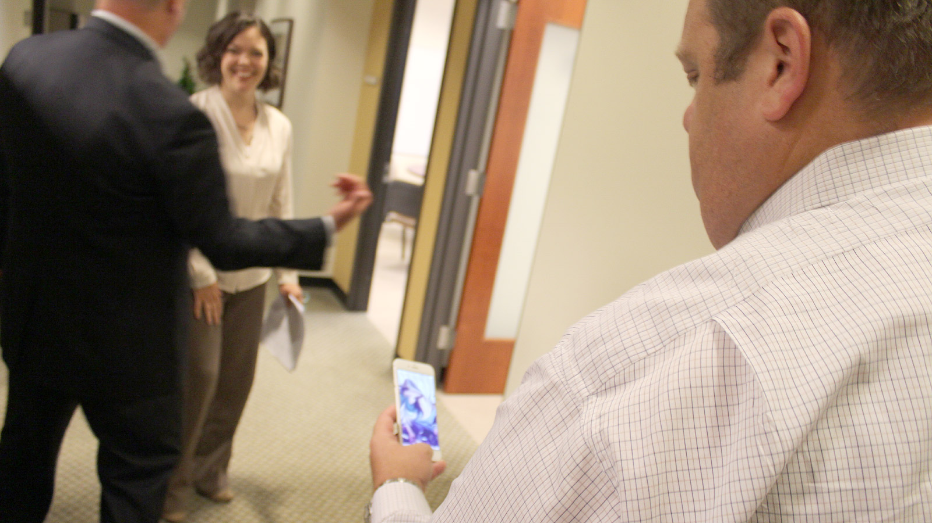
Insert picture of Mike and Anthony looking at one of their iphones

Slide 15
All was revealed.
Managed Accounts Concepting
Notes:
Open Item: Email Standards???

Slide 17
Pokémon Go: Lessons in Awesome We Can All Learn From
Your odds improve if you take action.
Business can benefit from hype. (Your friends in Marketing are here to help.)
Innovation gets attention.
Every so often you need to look where you’re going.
Managed Accounts Concepting
Notes:
Open Item: Email Standards???

